Slide 1
Movie Review Sentiment Analysis Using Deep Neural Networks
.

Slide 2
Group Member Information
Member 1 – Rajyalaksmi Gottipati (700745186)
Member 2 – Prem Sai Aravind Bevanasankalla (700750996)
Member 3 – Satwik reddy Mopuru (700740060)
Member 4 - Ushakiran Yadav Avula(700746114)

Slide 3
Role/Responsibilities and Contribution in project
Work Completed | Description | Responsibility (Task, Person) | Contributions (members/percentage)
Data preprocessing and exploratory data analysis | We have completed the implementation of sentiment analysis using machine learning in Python. We have loaded the dataset, preprocessed the data, performed exploratory data analysis, visualized the data, vectorized the data | Raji | 30%
Model definition and evaluation | defined the models including CNN1D, RNN, LSTM, and Bi-LSTM, evaluated the models using confusion matrix and graphs | Prem | 30%
real-time data testing | performed real-time data testing | Satwik | 20%
Fine-tuning the models | fine-tune the models to improve their accuracy and performance. | Ushakiran | 20%

Slide 4
Motivation
The use of machine learning algorithms for sentiment analysis has become a popular area of research in recent years.
Sentiment analysis is the process of extracting subjective information from text, such as opinions, emotions, and attitudes.
With the increasing amount of user-generated content on the internet, sentiment analysis has become an important tool for businesses to understand the opinions of their customers.
The motivation behind this project is to develop a sentiment analysis model that can accurately classify movie reviews as positive or negative.
This model can be used by movie studios to gauge the success of their films and make more informed decisions in the future

Slide 5
Objectives
The primary objective of this project is to develop a sentiment analysis model that can accurately classify movie reviews as positive or negative.
This model should be able to handle large volumes of text data and should have a high degree of accuracy.
Additionally, the model should be able to work in real-time, allowing for quick analysis of incoming reviews.

Slide 6
Related work
Sentiment analysis is a popular application of natural language processing that involves determining the emotional tone of a text.
One common approach to sentiment analysis is to use machine learning algorithms, which require large amounts of labeled data to train.
Text preprocessing techniques such as tokenization, stopword removal, and stemming are commonly used to prepare text data for sentiment analysis.
Vectorization is an important step in sentiment analysis, which transforms text data into a numerical format suitable for machine learning models.
Convolutional neural networks (CNN), recurrent neural networks (RNN), long short-term memory (LSTM), and bidirectional LSTM (Bi-LSTM) are commonly used deep learning models for sentiment analysis.
Evaluation metrics such as accuracy, precision, recall, and F1-score are used to evaluate the performance of sentiment analysis models.
Future work in sentiment analysis includes improving the accuracy of models for low-resource languages and incorporating multimodal information such as audio and visual data.

Slide 7
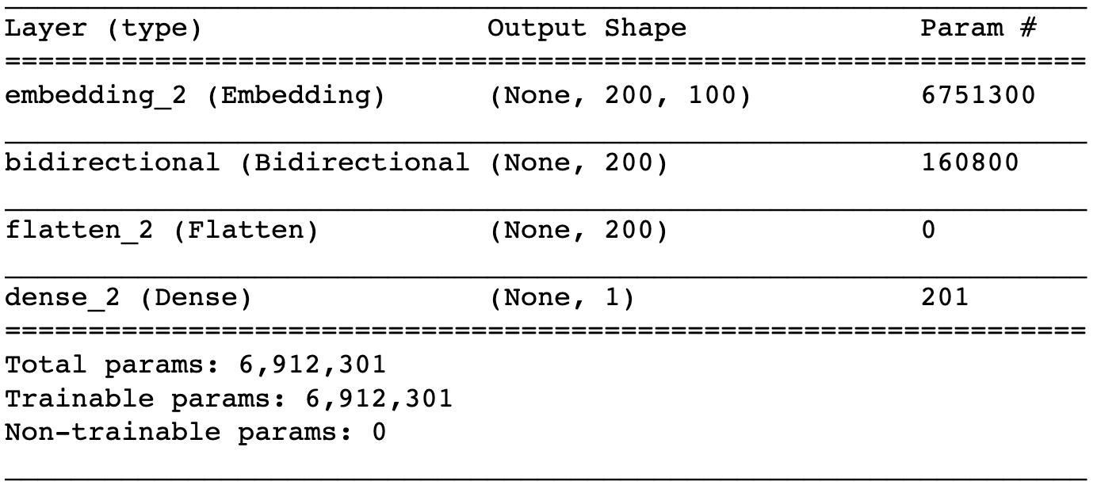
CNN1D (Convolutional Neural Network)
Convolutional Neural Networks (CNNs) have been widely used in image classification tasks, but they have also shown promising results in natural language processing tasks such as sentiment analysis. In a 1D CNN, the convolutional operation is performed on one-dimensional sequences, such as text data. The CNN1D model is composed of several layers, including a convolutional layer, a pooling layer, and a dense layer.
The convolutional layer uses filters to scan the input sequence and identify patterns in the data. The size of the filter determines the number of words in the input sequence that are considered at a time. The pooling layer reduces the dimensionality of the feature maps generated by the convolutional layer. Finally, the dense layer performs classification by mapping the features to the target labels. The CNN1D model has several advantages, including the ability to capture local dependencies and the ability to learn complex features. However, it may struggle with capturing long-range dependencies in the input sequence.

Slide 8
RNN (Recurrent Neural Network) and LSTM (Long Short-Term Memory)
Recurrent Neural Networks (RNNs) are designed to handle sequential data by processing each element in the sequence while maintaining an internal state that summarizes the previous elements. In a standard RNN, the internal state is updated at each time step using a set of weights that are shared across all time steps.
Long Short-Term Memory (LSTM) is a type of RNN designed to address the vanishing gradient problem. The LSTM model includes an additional set of gates that regulate the flow of information into and out of the cell state, allowing the model to selectively remember or forget information over time.

Slide 9
Problem Statement
To develop an accurate sentiment analysis model that can classify a given text into positive or negative sentiment.
The model should be able to handle different types of text data, including social media posts, product reviews, and news articles.
The goal is to help businesses and organizations gain insights into customer feedback, monitor their brand reputation, and make data-driven decisions.
The challenge is to build a model that can effectively capture the nuances of human language and context, while also being scalable and efficient.

Slide 10
Proposed Solution
Preprocessing of text data by removing stop words, stemming, and other necessary text cleaning steps.
Vectorizing preprocessed text into numerical vectors using techniques such as word embedding or bag-of-words.
Building a sentiment analysis model using machine learning algorithms such as CNN1D, RNN, LSTM, and Bi-LSTM.
Evaluating the model using metrics such as accuracy, precision, recall, and F1-score.
Testing the model in real-time to allow users to enter movie reviews and get instant feedback.
Using the model to identify areas of improvement in films and gauge audience reaction, which can help studios make informed decisions about future projects and marketing strategies.
Automating the process of assigning scores to films based on their reviews for movie review websites.

Slide 11
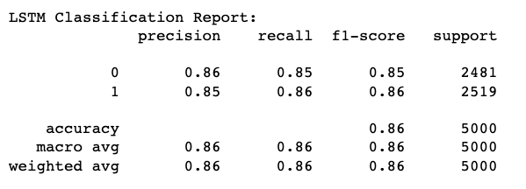
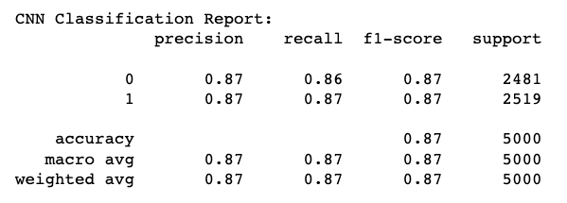
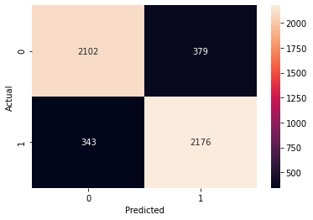


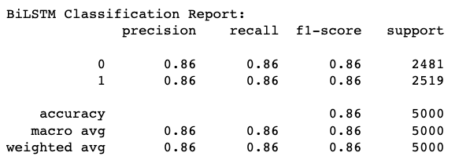
Results

Slide 12
Reference
Pang, B., & Lee, L. (2008). Opinion mining and sentiment analysis. Foundations and Trends® in Information Retrieval, 2(1-2), 1-135.
Liu, B. (2012). Sentiment analysis and opinion mining. Synthesis lectures on human language technologies, 5(1), 1-167.
Socher, R., Perelygin, A., Wu, J. Y., Chuang, J., Manning, C. D., Ng, A. Y., & Potts, C. (2013, October). Recursive deep models for semantic compositionality over a sentiment treebank. In Proceedings of the conference on empirical methods in natural language processing (EMNLP) (Vol. 1631, p. 1642).
LeCun, Y., Bengio, Y., & Hinton, G. (2015). Deep learning. Nature, 521(7553), 436-444.
Collobert, R., & Weston, J. (2008). A unified architecture for natural language processing: Deep neural networks with multitask learning. In Proceedings of the 25th international conference on Machine learning (pp. 160-167).
Kim, Y. (2014). Convolutional neural networks for sentence classification. arXiv preprint arXiv:1408.5882.
Hochreiter, S., & Schmidhuber, J. (1997). Long short-term memory. Neural computation, 9(8), 1735-1780.
Graves, A., & Schmidhuber, J. (2005). Framewise phoneme classification with bidirectional LSTM and other neural network architectures. Neural Networks, 18(5-6), 602-610.
Pennington, J., Socher, R., & Manning, C. D. (2014). Glove: Global vectors for word representation. In Proceedings of the 2014 conference on empirical methods in natural language processing (EMNLP) (pp. 1532-1543).

